Slide 1

Session 6
List - Tuple

Slide 2
The “collection” data types
After having mastered basic data types such as int, float, string and bool, we can organize them into “collections” - that is data types that can hold multiple values

Slide 3
TABLE OF CONTENTS
01
02
List data type
Tuple data type

Slide 4
01
List in Python

Slide 5
What is a “list”?
A type of collection which allows storing multiple values, either homogeneous or mixed
Sort of like the “array” data type in other languages
Initialize with the syntax [item1, item2,...] or the list((item1, item2,...)) function
Items start at index 0
scores = [5, 6, 6.5, 10]
players = list(('john', 'anna', 'tom', 'kelly'))

Slide 6

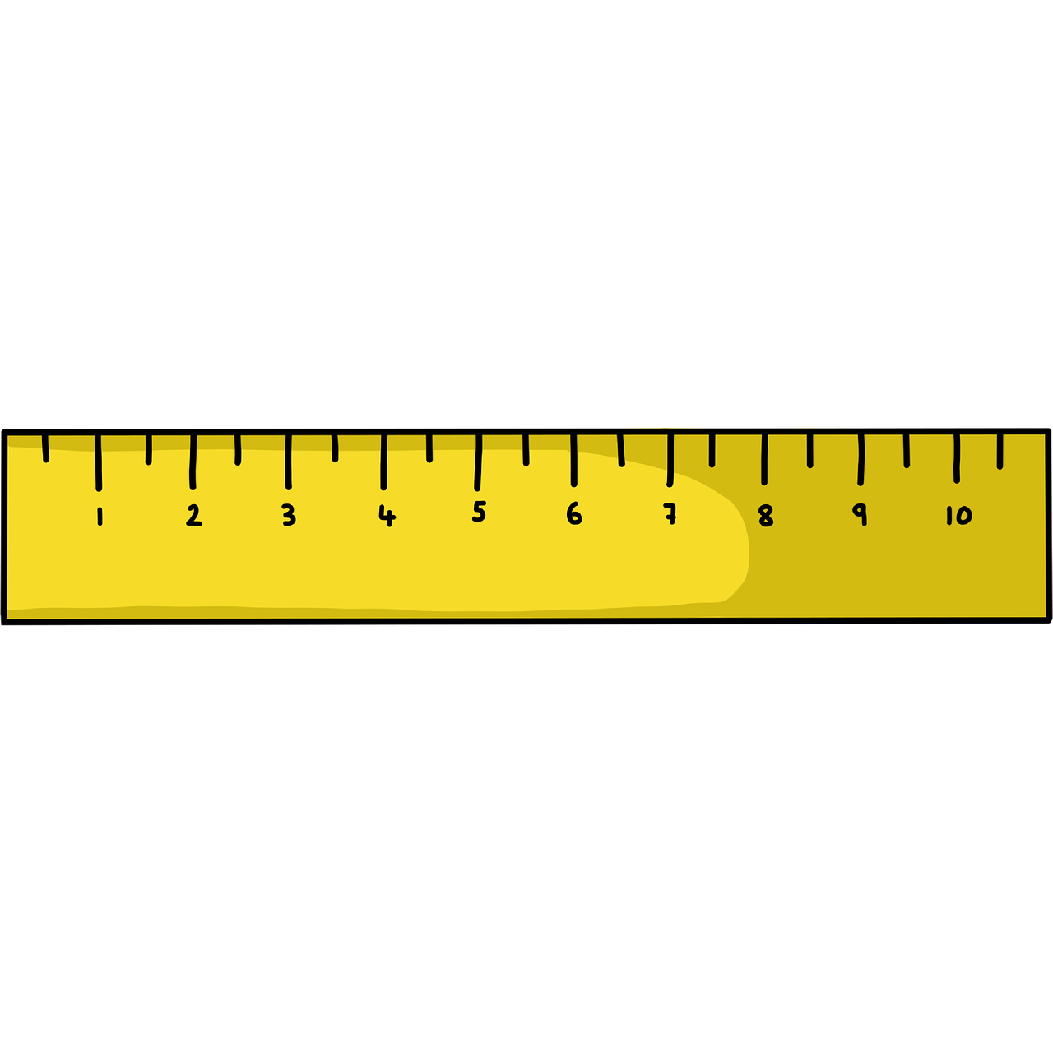

Common list operations
list[position]
len(list)
item in list
Access item by index, also re-assigning
Get the item size of the list
Check if item exists in a list

Slide 7


Common list methods: Add element(s)
list.append(item)
list.insert(item)
list.extend(item)
Add a new element at specific position
Add 1 new item to the end of the list
Add several items to the end of the list

Slide 8
Joining 2 lists
The + operator
list1 = ["a", "b" , "c"]
list2 = [1, 2, 3]
list3 = list1 + list2
print(list3)
extend() method
list1 = ["a", "b" , "c"]
list2 = [1, 2, 3]
list1.extend(list2)
print(list1)

Slide 9



Common list methods: Delete element(s)
list.remove(item)
list.clear()
del(list[index])
list.pop(index)
Delete element(s) by index
Delete an element by value
Delete an element by index & return that elements value
Default: the last element in the list
Clear the whole list
del is a keyword!!

Slide 10


Common list methods: Organize list
list.sort(item)
list.reverse()
sorted(list)
Sort the list in alphabetical order
(mutate the list)
Builds a new sorted list from an interable
(NOT mutate the list)
Reverse the original order of a list
sorted is a built-in function!!

Slide 11
for <item> in list:
for i in range(len(list)):
Loop through the whole list, each item is represented by the item variable
Loop through the whole list with the index, access the element with list[i]

Slide 12
Some note about mutability vs immutability
A list can add and remove values, which is why it’s called a mutable data type
Unlike int, float, string,... where if you want to change the value of the variable, you have to reassign it, the value itself can’t be changed, meaning it’s immutable

Slide 13

Copying a list
When assigning a list variable to a second variable, the second variable will hold a reference to the list, not the copy the list. Any modification to the second variable will reflect back the original list
To copy the list to another variable and preserve the original list, use the copy() method

Slide 14
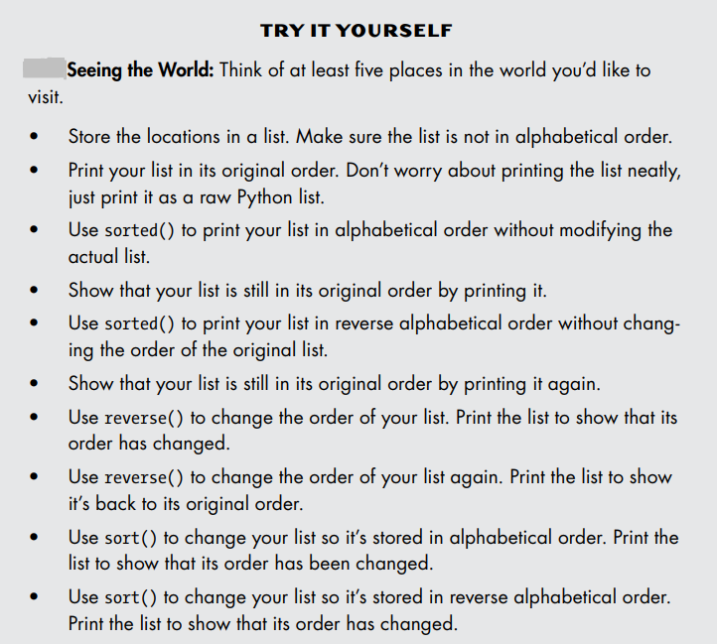

Slide 15
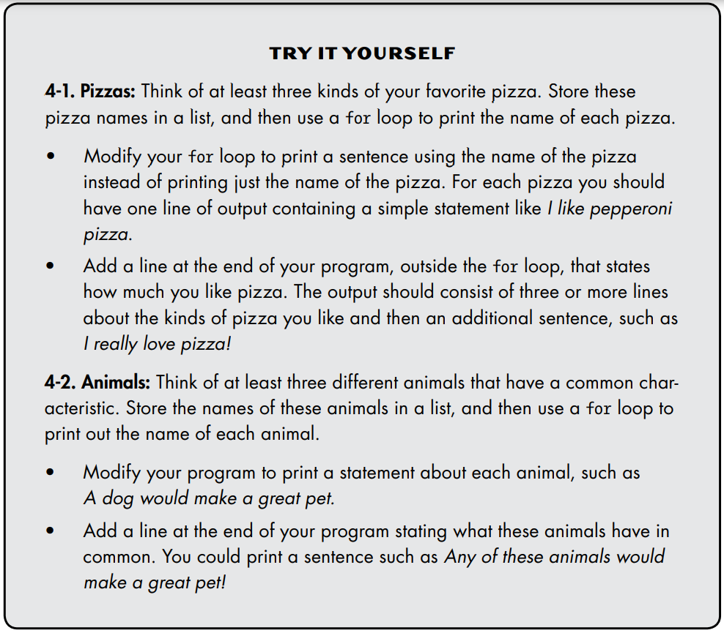

Slide 16
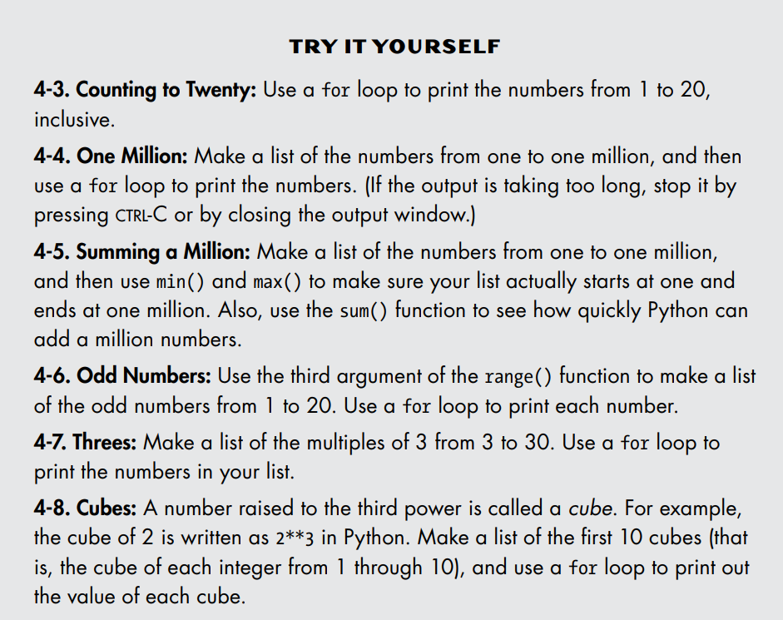

Slide 17
Documents
5. Data Structures — Python 3.10.0 documentation
Python Tutor - Visualize Python, Java, JavaScript, C, C++, Ruby code execution

Slide 18
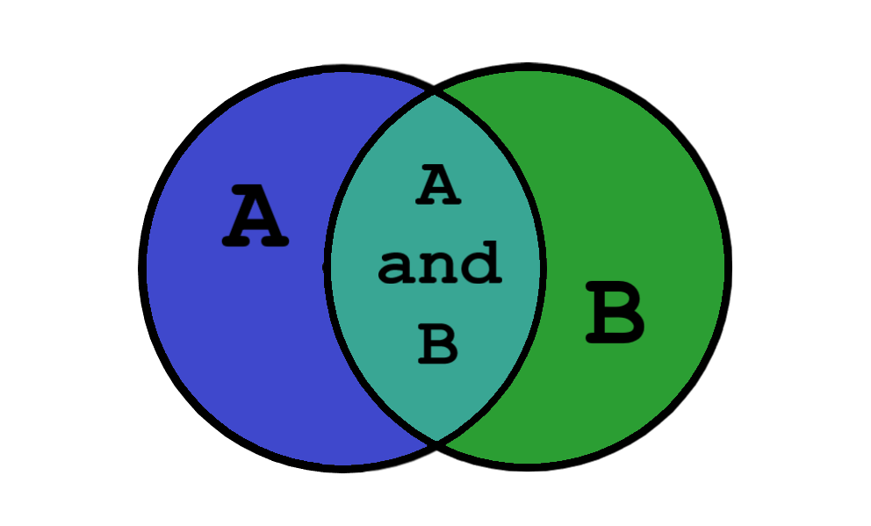
02
Tuple in Python

Slide 19
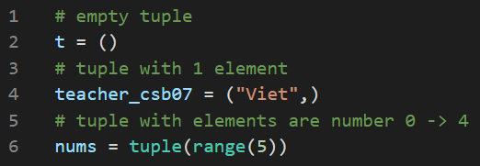
What is a “tuple”?
Sort of like list, set allows storing multiple items, either homogeneous or mixed
However, tuple does not allow changing items in it

Slide 20
List and Tuple

Slide 21
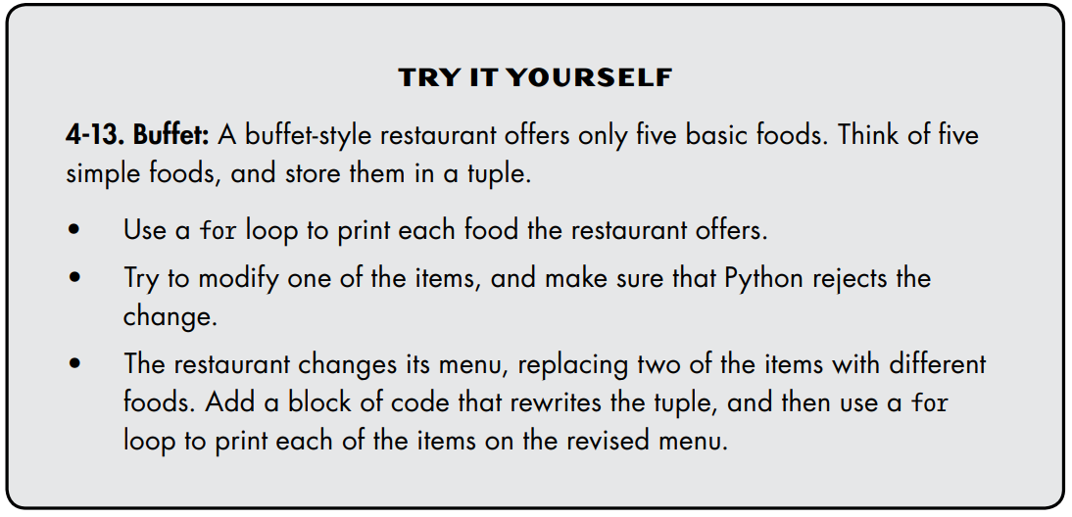

Slide 22
THANKS!
See you in the next lesson!
Please keep this slide for attribution.

